Slide 1
MRC Annual Membership Meeting
December 12, 2018
Machias Savings Bank, Community Room
581 Wilson Street, Brewer, Maine

Slide 2
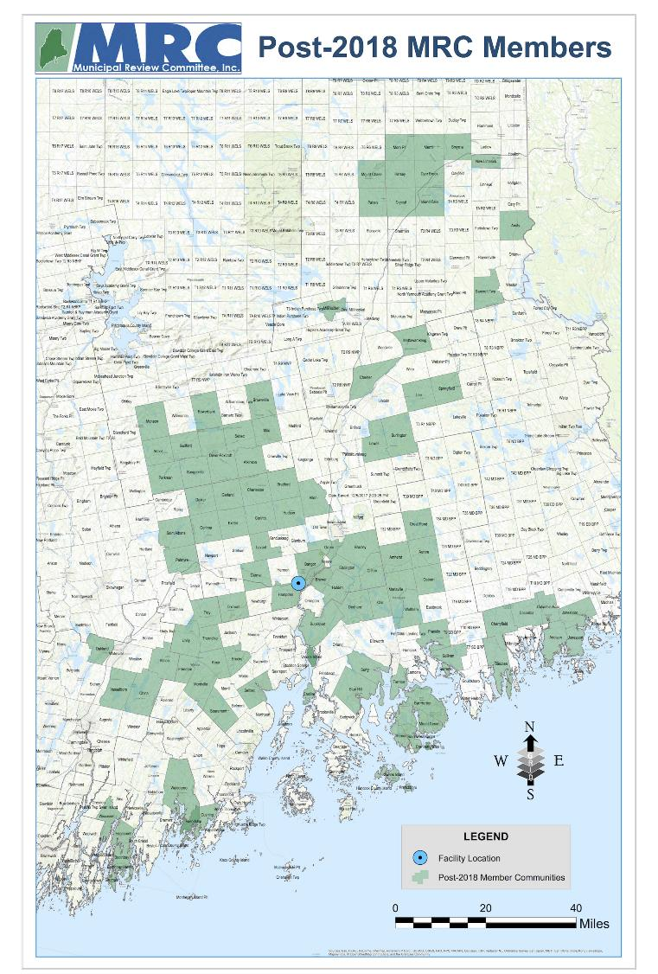
Welcome
Chip Reeves, MRC Board President
MRC’s mission
  Affordable
  Environmentally sound
  Focused on the long-term
2018: A Year of Transition
  Wind-up of the PERC arrangements
  Continued construction of Coastal Hampden Facility
  Manage MSW during the transition
  Perform new MRC roles in the new arrangements

Slide 3
Year Ahead | Challenges and Optimism
Chip Reeves, MRC Board President
Continue to monitor swap agreements
Reduced MRC revenues
COD of Coastal Resources of Maine in sight

Slide 4
Year in Review
Greg Lounder, MRC Executive Director
Completed and exited all prior arrangements amicably
  Waste Disposal Agreements – PERC accepted MSW from all Charter Municipalities through March 31, 2018
  MRC-PERC Settlement Agreement – all obligations were satisfied
  Put Option – closed on PERC purchase of Equity Charter Municipality ownership positions
  Departing Municipality Agreements – MRC completed audit of balances and allocations and made payments in September 2018

Slide 5
Infrastructure Overview
Greg Lounder, MRC Executive Director
Road acceptance
Water and sewer – completed system upgrades
Electricity – site now has power

Slide 6
Interim MSW Disposal Period
Greg Lounder, MRC Executive Director
Directing MSW deliveries during interim period
Using agreement secured in 2015 for access to Crossroads
Secured swap agreement for access to Juniper Ridge to reduce transportation costs and impacts during the transition
Reimbursing MRC members for extra transportation-related costs
Rebates to MRC members prior to commercial operation

Slide 7
MRC Financial Obligations to Joining Members
George Aronson, Commonwealth Resource Management
Obligation | Reference
Offset additional costs of Bridge Waste transportation prior to the Commercial Operation Date (COD) | Joinder Agreements, Section 6.2 and Exhibit B, Section 2(c)
Pay allocable shares of Custody Account and Tip Fee Stabilization Fund to Departing Municipalities | Joinder Agreements, Exhibit B, Section 2(b)
Pay rebates of $5/ton to former Equity Charters and $3/ton for former New Charters prior to the COD | MRC Board decision effective April 1, 2018
Pay rebates of $5/ton to former Equity Charters and $3/ton for former New Charters after the COD | Joinder Agreements, Exhibit B, Section 2(c)
Maintain Reserve Funds | Joinder Agreements, Exhibit B, Section 2(c)
Monitor revenues and performance and distribute rebates paid by Coastal after COD | Joinder Agreements, Section 5.3; Master Waste Supply Agreement

Slide 8
MRC Performance on Obligations
George Aronson, Commonwealth Resource Management
Obligation | Performance
Offset additional costs of Bridge Waste transportation from $1.0 M in reserves | Paid out $355,000 to date; Forecast paying $720,000 by COD
Pay allocable shares to Departing Municipalities | Payments escrowed in April 2018; payments made in September 2018 after audit was completed
Pay rebates to Joining Members | Paid out $248,000 in 2nd and 3rd quarter 2018. Forecast paying $294,500 for next three quarters
Monitor performance and revenues, and distribute rebates paid by Coastal | Performance and revenue monitoring will begin after COD

Slide 9
MRC Reserve Funds
George Aronson, Commonwealth Resource Management
Reserve Fund | Commitment | Spent | Balance | Source
Building Reserve | Maintain $7.0 M through Site Lease term | Zero | $7.0 M | $4.0 in the Tip Fee Stabilization Fund; $3.0 M in the Cash Collateral Account (dual use)
Delivery Assessment Fund | Maintain $3.0 M through Master Waste Supply Agreement term | Zero | $3.0 M | Cash Collateral Account (dual use)
Closure Reserve Fund | Maintain $1.167 M until complete; reconsider need in 2018 | $185 k | $982 k | Tip Fee Stabilization Fund and Custody Accounts – amounts will be re-allocated
Bridge Waste Fund | Set aside $1.0 M until COD, then return balance to Target Reserve | $355 k | $ 645 k | Tip Fee Stabilization Fund and Custody Accounts
Target Reserve Fund | Distribute $1.5 M to Joining Members in 36 months after COD | Zero | $1.50 M | Tip Fee Stabilization Fund and Custody Accounts

Slide 10
Other MRC Obligations and Services
George Aronson, Commonwealth Resource Management
Interim Period prior to Commercial Operation Date (COD)
Monitor completion of infrastructure and construction; oversee all Site activities
Manage MSW deliveries to back-up facilities
Coordinate MSW delivery to the Hampden Facility during the ramp-up period
Negotiate/witness Acceptance Test
Secure access to favorable processing fee for single-sort recyclables
Clarify/negotiate programs for materials that would be residuals and not processable
After COD
Track MSW tons and delivery patterns/methods; coordinate among Joining Members
Monitor Facility operations and performance
Oversee further facility additions
Address unforeseen events and uncontrollable circumstances

Slide 11
Treasurer’s Report
Sophie Wilson, MRC Board Treasurer

Slide 12
Treasurer’s Report
Sophie Wilson, MRC Board Treasurer

Slide 13
Election Update
Greg Lounder, MRC Executive Director
To be announced on December 28, 10 AM via conference call
Return ballot to MRC before 5:00 PM, December 27

Slide 14
Thank you, Gary!

Slide 15
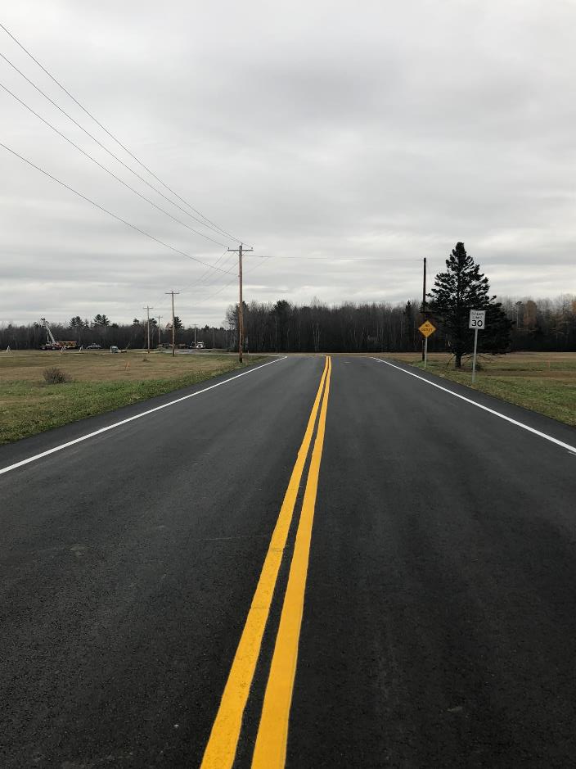
Fiberight
Coastal Resources of Maine
MRC Annual Meeting Dec 2018

Slide 16
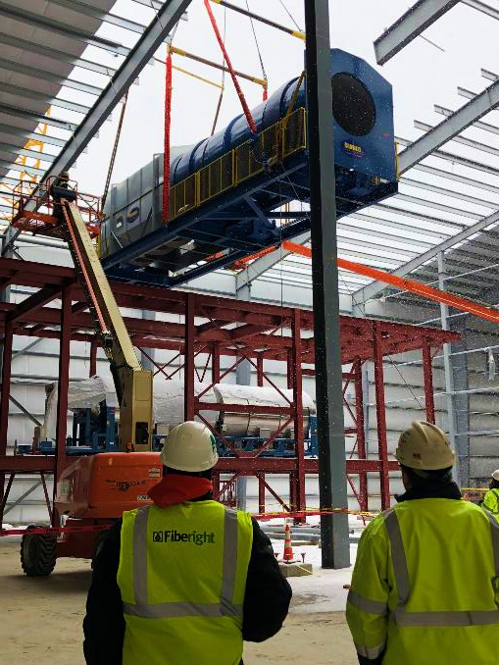
Construction Update
The pulper support steel was installed, minus stairways, grating, and handrails.​
The drum pulper and wash tunnel have been installed. ​
Paving completion allowed for the streamlining of delivery receiving and storage. ​
Transformers are in place and high voltage wiring is being pulled.​
Structural steel and decking are complete on mechanical room roof.​
The scale house has been delivered and scales scheduled to arrive this week. ​
Heat pumps have been installed in the Porta-king Temperature Control Building. ​
Winbco has mobilized on site and completed 2 tanks in the Tank Farm.​
NS Giles has completed concrete slabs and piers for HVAC. All other ​
exterior concrete placements will be completed this week.​
Bancroft continues to mobilize and increase manpower in compliance ​
with the schedule for equipment, steel, and piping installations.​

Slide 17
Facility Overview Video
Click the link below for a drone video of the construction equipment an d progress of the Fiberight/Coastal Resources of Maine Hampden facility.
https://youtu.be/dOR31qtVGh8
Notes:
When in edit mode right click the black box, then select preview.

Slide 18
3D Modeling of the “Wet End”
Click the link below for a video of the 3D Modeling of the “Wet End” at the Fiberight/Coastal Resources of Maine Hampden facility.
https://youtu.be/6N7tfaY8Jcs
Notes:
When in edit mode right click the black box, then select preview.

Slide 19
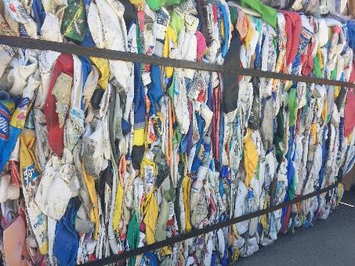
Fiberight’s Functionality
PROCESSING MATERIALS HELPS AVOID VOLATILE MARKETS
China’s Green Sword and the International Repercussions for Recycling Markets
Fiberight’s unique method of producing finished products that don’t rely on overseas markets protects us from unpredictable and extreme fluctuations. This allows us the flexibility to offer a better and more economically sustainable way to manage MSW and recycling.
Products Produced for Revenue
Bulk – Cellulose/Pulp, Plastics-derived Fuel Briquettes,
Mixed metals, BioGas
Baled - OCC (Cardboard), Aluminum Cans, Steel Cans,
Plastics Grade 1(PET) & 2 (HDPE)
We will also be shipping out Alternative Daily Cover (ADC) from clean process fines

Slide 20
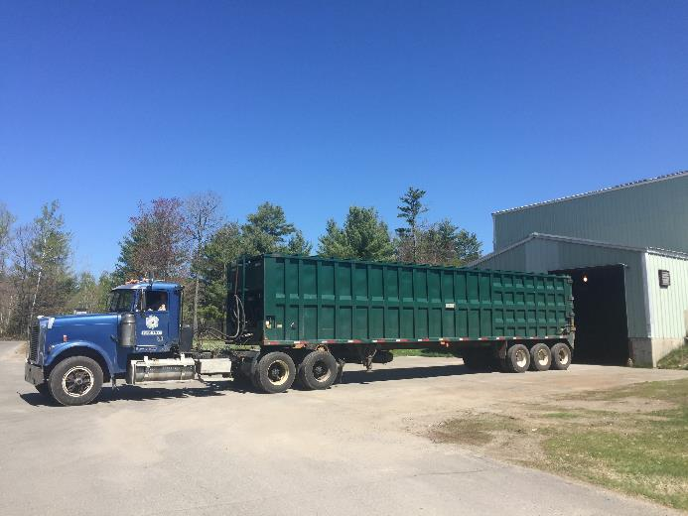
Onboarding Plan
STOP START, START SWING, NON-STOP
Methodology
3 Onboarding Groups based on:
Transportation expenses, Delivery Methods,
Geography, Clear preference to avoid landfill,
MSW Tonnage generated per month, multiple loads
per week
Ramp up Tonnage (MSW & SSR)
Month 1 – 1650 tons
Month 2 – 5000 tons
Month 3 – 7900 tons
Order of Acceptance
All SSR and Group A – Start Stop
All SSR, Groups A & B – Stop Start to Start Swing
All SSR, Groups A, B & C – Start Swing to Non-Stop

Slide 21

Education and Outreach
PUBLIC OUTREACH AND FACILITY ASSISTANCE FOR TRANSITION
Onboarding Workshop for Transfer Station Managers and Operators is tomorrow and includes a tour of CRM
  2nd workshop being planned for Curbside communities and Haulers.
  Workshops will give clearer focus/scope of needed outreach
www.CoastalResourcesME.com is in Development for Jan 2019
Textile and Garment Recycling w/ Apparel Impact
Guidance/Best Practices Documents will be developed
Single Stream Recycling Materials are being finalized
Facility and Operations tours continue

Slide 22

Recycling Contract Template
SINGLE STREAM RECYCLING SERVICES FOR MRC COMMUNITIES
Overview of Contract Details
  Tipping fee for Single Stream Recycling (SSR) is 50% of MSW Tip fee for Joining Members of MRC.
  SSR refers to single stream recycling collected under a Town operated or sponsored program with provisions made for Private Waste Generators.
  "Private Waste Generators" means non-residential generators of waste located within the boundaries of the Town that have advised the Town of their desire to deliver Recyclable Materials to the Facility and that are included on a list of Private Waste Generators furnished by the Town to Coastal Resources (CRM).
  Contracts will be signed by MRC Joinder Communities and CRM directly.
Single Stream Recycling Materials are being finalized.

Slide 23
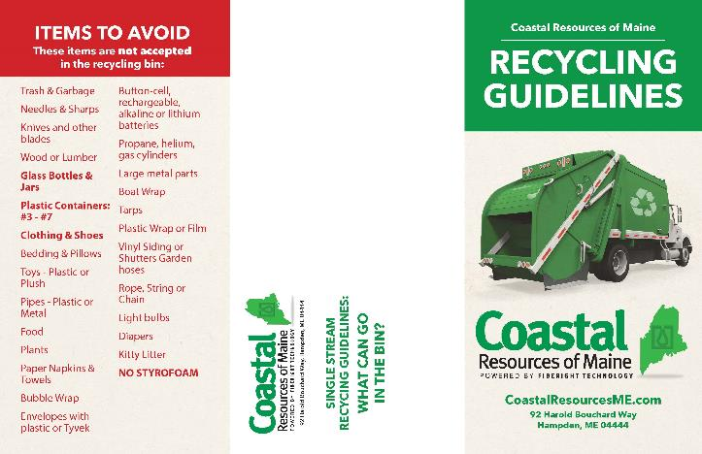
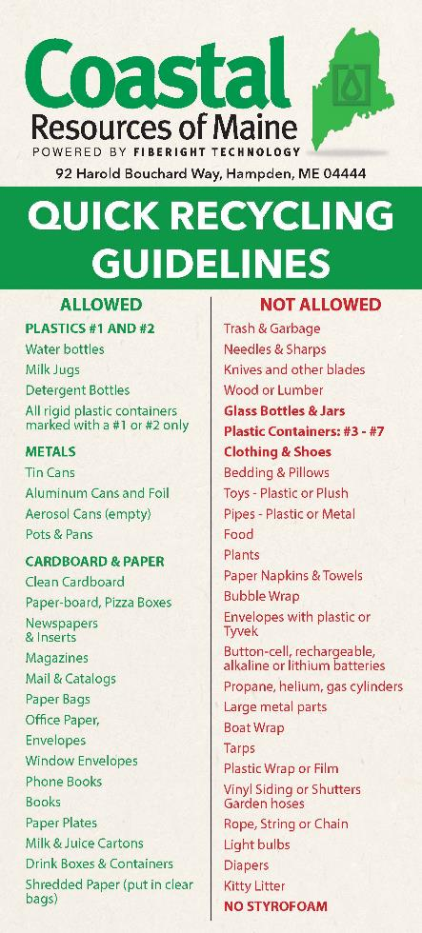



Slide 24

www.CoastalResourcesME.com
NEXT GENERATION RECYCLING ONLINE
About CRM
Coastal Resources of Maine
Member Communities
Municipal Solid Waste Delivery Schedule
Services
Municipal Solid Waste Solutions
Single Stream Recycling Options
Textile and Garment Recycling
Education and Outreach Programs
Resources
Helpful Links
Downloadable Templates
CRM’s Next Generation Recycling Technology
Contact Us
Send an email
Request a group tour of the Facility

Slide 25

Thank You!

Slide 26
THANK YOU!
Questions?
Please contact
Greg Lounder
MRC Executive Director
glounder@mrcmaine.org
(207) 664-1700
www.mrcmaine.org

